Slide 1
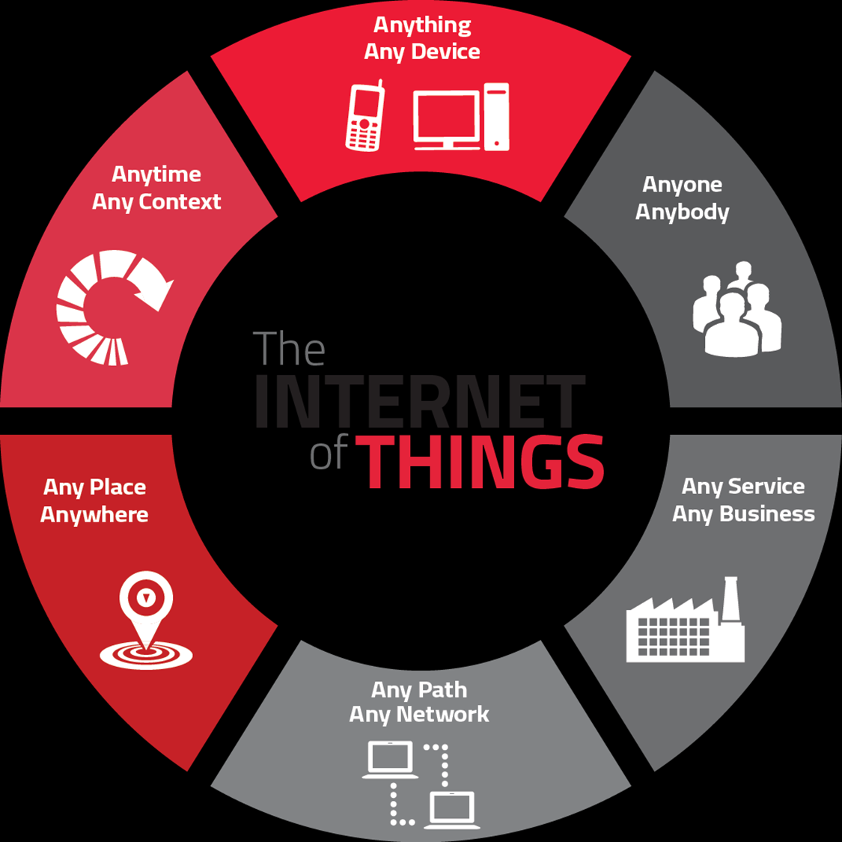
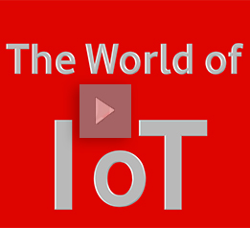
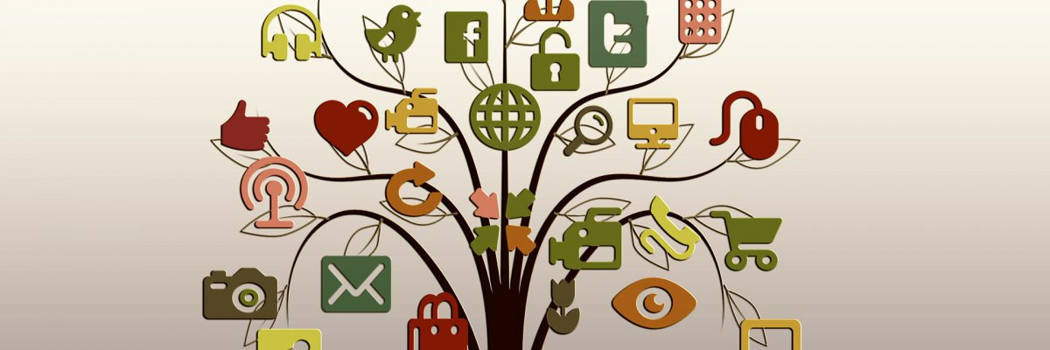

Slide 2
Plan of Presentation
What is Internet of Things?
History of IoT
How IoT Works?
Few Applications of IoT
Evolution of connected devices
The Future of IoT
Criticisms & Controversies of IoT
Summary
2

Slide 3

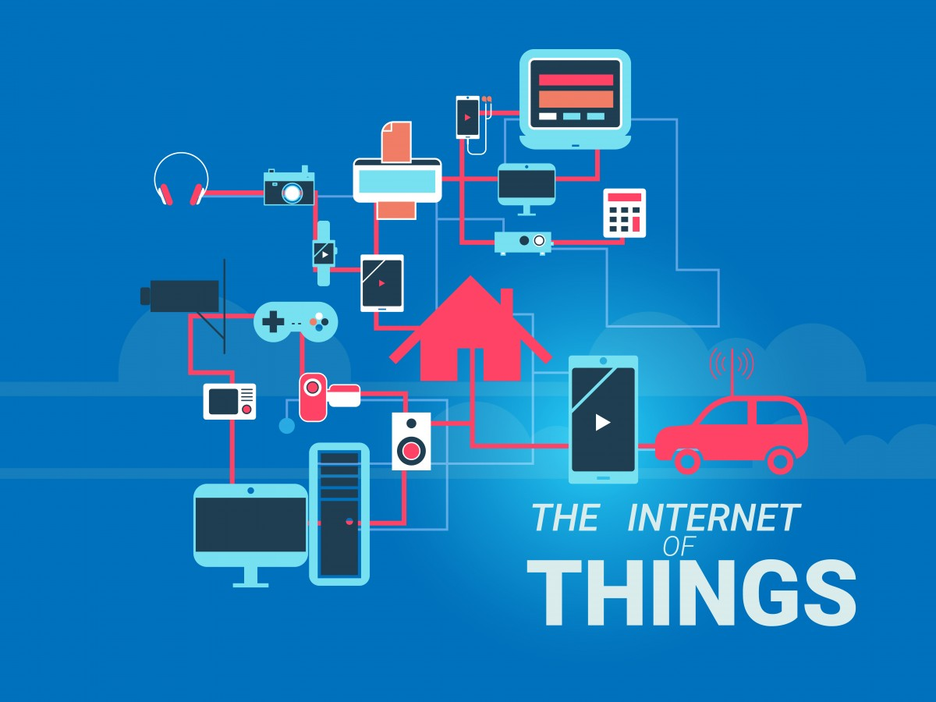
DEFINITION
The Internet of things (IoT) is the network of physical devices, vehicles, home appliances, and other items embedded with electronics, software, sensors and network connectivity which enable these objects to connect and exchange data.
OR
The vision of the internet of things is to attach tiny devices to every single object to make it identifiable by its own unique IP address. These devices can then autonomously communicate with one another.

Slide 4

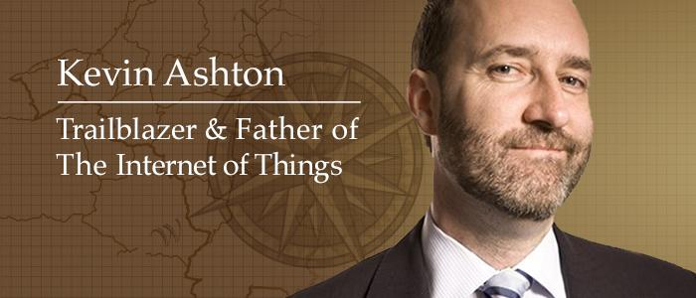
The Internet of Things (IoT) has not been around for very long. However, there have been visions of machines communicating with one another since the early 1800s. The Internet of Things, as a concept, wasn’t officially named until 1999.
Kevin Ashton, the Executive Director of Auto-ID Labs at MIT, was the first to describe the Internet of Things.

Slide 5
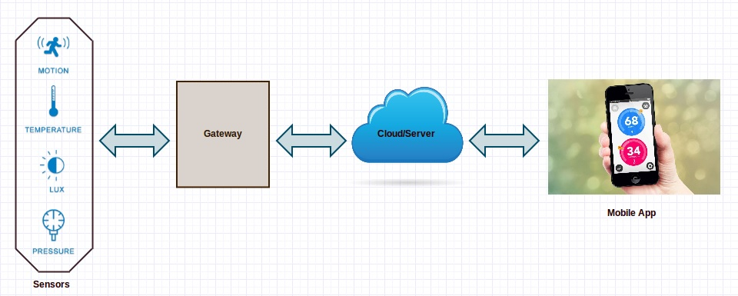
How an IoT System Actually Works?
A complete IoT system integrates four distinct components:
1.Sensors
2. Connectivity
3. Data processing
4.User interface.

Slide 6
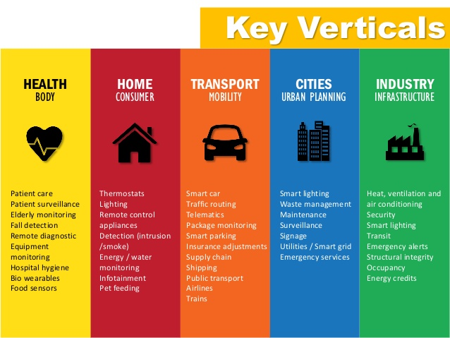
applications

Slide 7
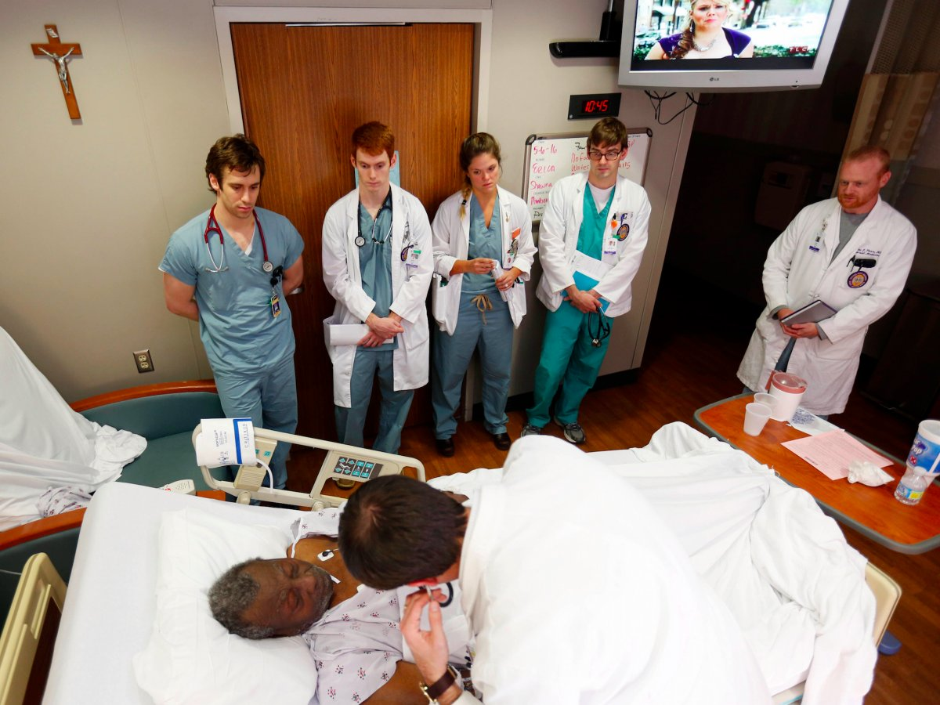
healthcare
The IoT (Internet of Things) and the mobile technologies make it easier to monitor the patients health conditions by sharing the health information to health care teams such as doctors, nurses and specialists. However the guardians of the patients can be anxious about their patients when they are in work. By ensuring guidance awareness about the patients, it can bring more liability of the hospital management.

Slide 8
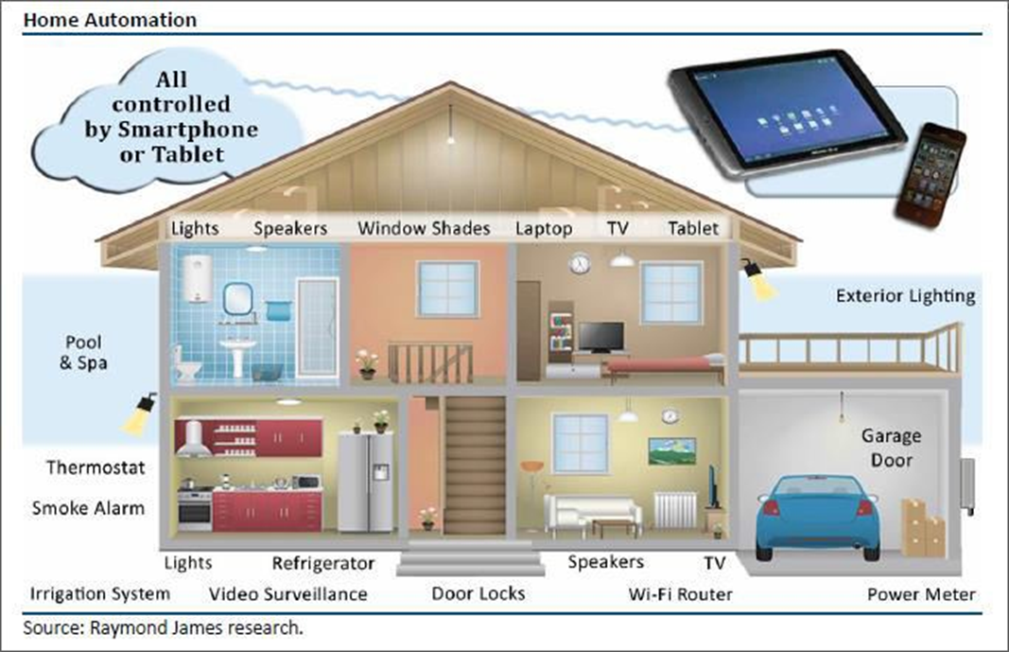
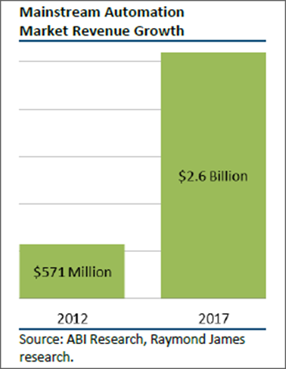
Smart home
The smart home is likely the most popular IoT application at the moment because it is the one that is most affordable and readily available to consumers. There are hundreds of products on the market that users can control with their voices to make their lives more connected than ever

Slide 9
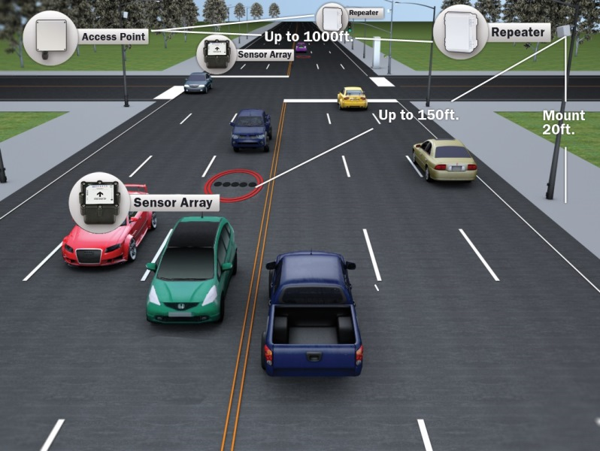
transportation
Sensors and smart software can also be used in a semi-truck or public bus to collect data that can be used to help the driver operate the vehicle in a manner that helps save fuel. What's more, Intel provides IOT solutions that can be used to monitor how safely a driver is driving and can help predict when fleet vehicles may need repairs in real-time.
In the future, connected infrastructure will also work with connected vehicles to help reduce traffic and prevent accidents.

Slide 10
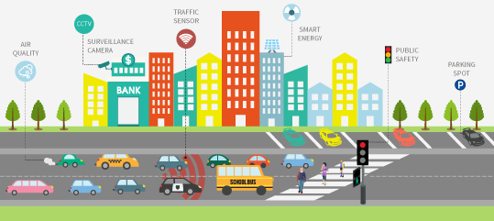
SMART CITIES
The IoT has the potential to transform entire cities by solving real problems citizens face each day. With the proper connections and data, the Internet of Things can solve traffic congestion issues and reduce noise, crime, and pollution.

Slide 11

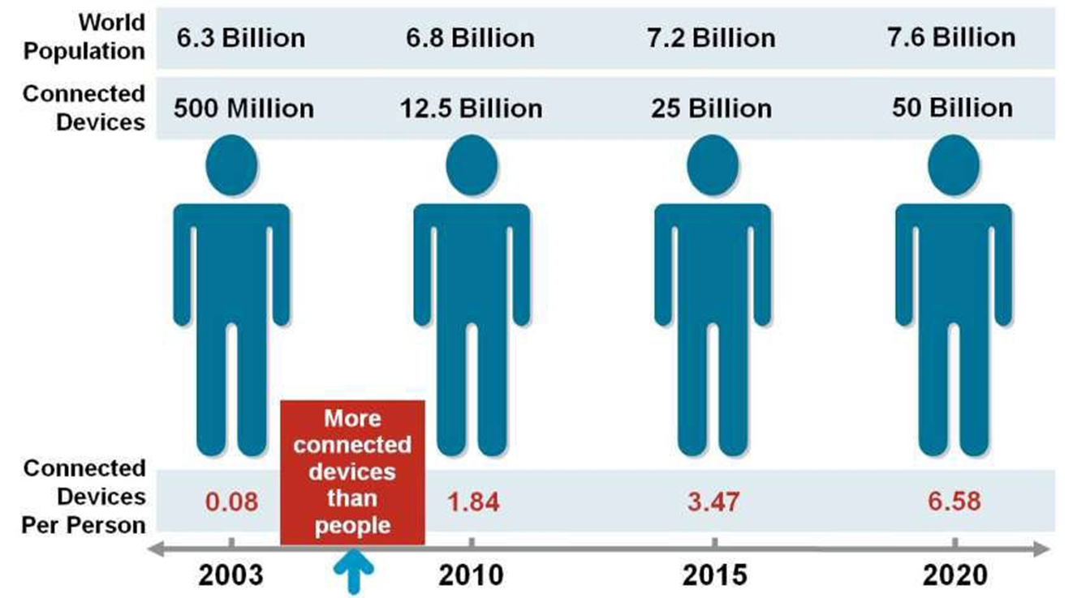

Slide 12
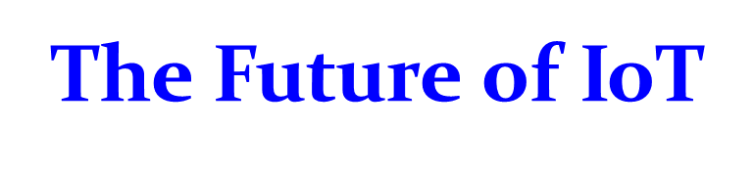
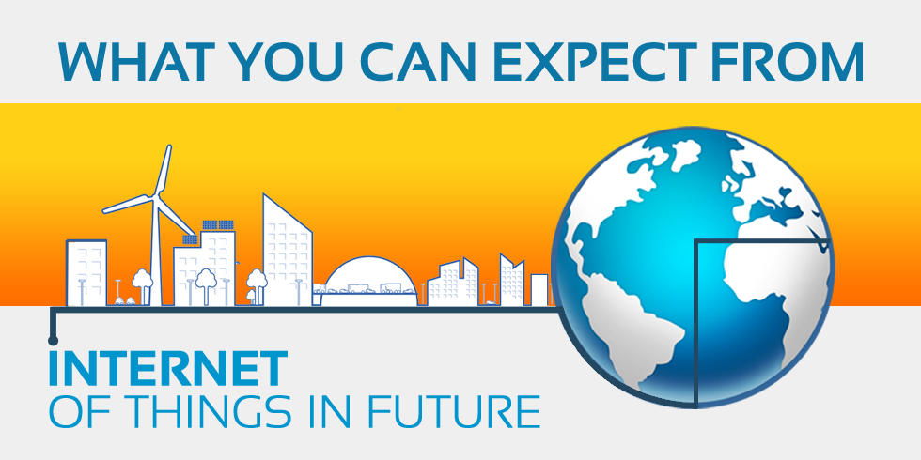
Need for a new internet: Internet of Things

Slide 13
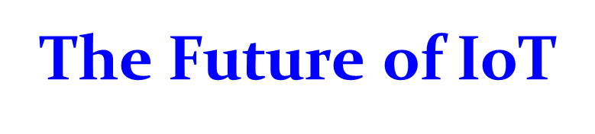
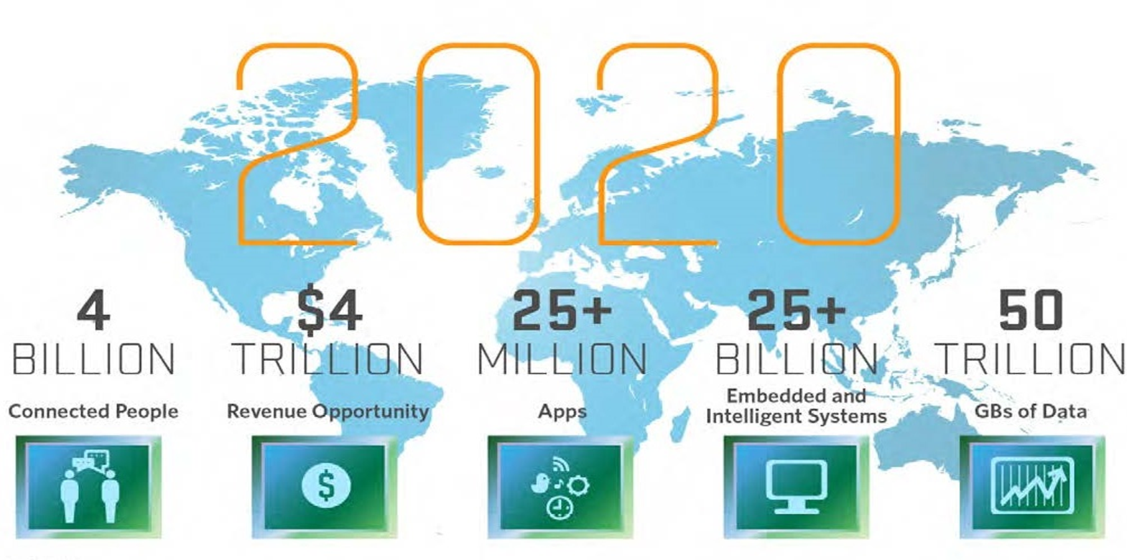

Slide 14

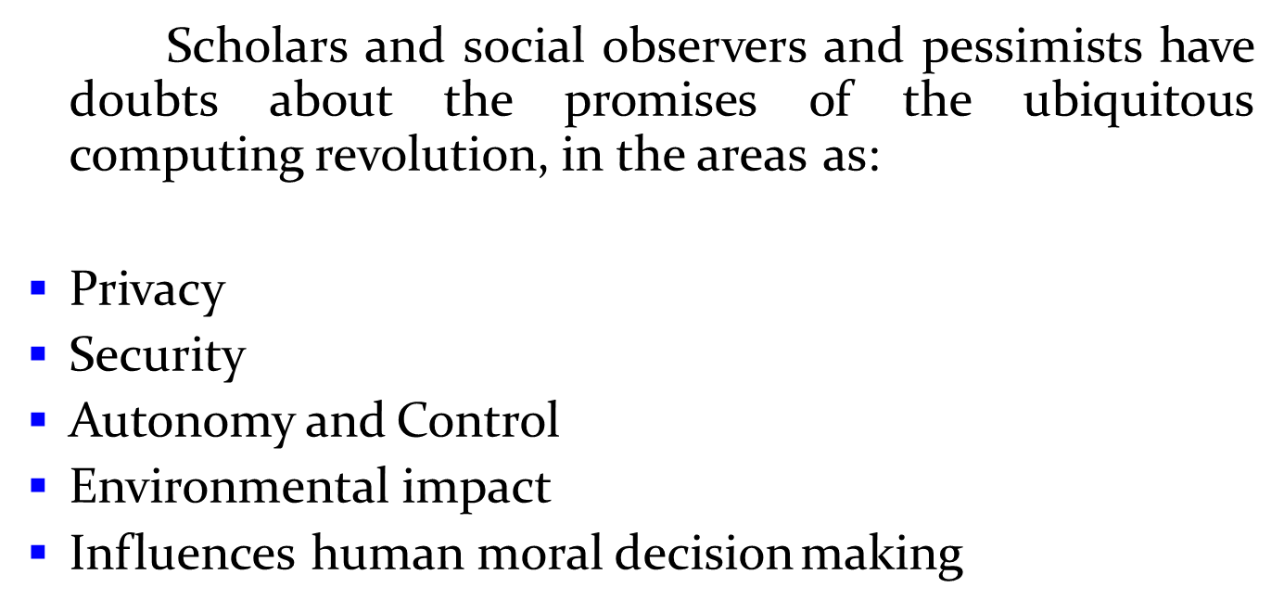

Slide 15
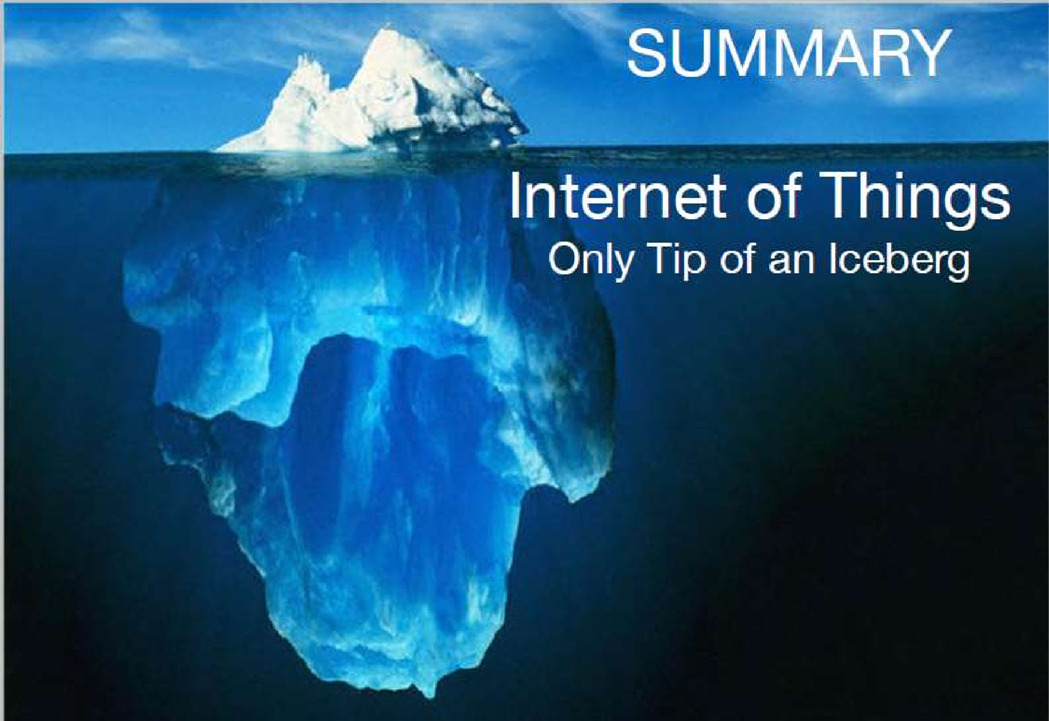

Slide 16


